Slide 1

Adult Sunday School Class
- Starts Sun Nov 8th – Goes for 5-Weeks – 8:10 to 8:55am – Downstairs Classroom TBD -
How did we get
the Bible?
- Sign-Up at the Back Table -

Slide 2
Partnership class & identity class opportunities
WHAT:
  Partnership Class: For those Interested in becoming a partner with Bend City or those simply interested in sharpening your knowledge on about Foundations of Faith.
  Identity Class: For those looking to meditate on what it looks like to practically find their identity in Christ.
WHEN: Saturday, Nov 14th 9:30am-noon
WHERE: Downstairs in various classrooms

Slide 3

Monthly Prayer Night
WEDNESDAY, Nov 18th
6:30-7:30 PM
Kid City Room
The Monthly Prayer Night happens every third Wednesday the month.
(Childcare Provided)

Slide 4

21st Annual Seed of Hope Gala Fundraiser
- Friday November 6th - 5 to 9pm - Chandelier Ballroom Hartford -
Evening Includes:
- Dinner -
- Live Auction for Desserts -
- Silent Auction for Baskets -
- $60 per Ticket -
Want to bring a Basket for the Silent Auction?
Bring your basket to Church by Oct 18th OR Seed of Hope by Oct 22nd
Registration and Details at:
seedofhopepartners.org/events

Slide 5
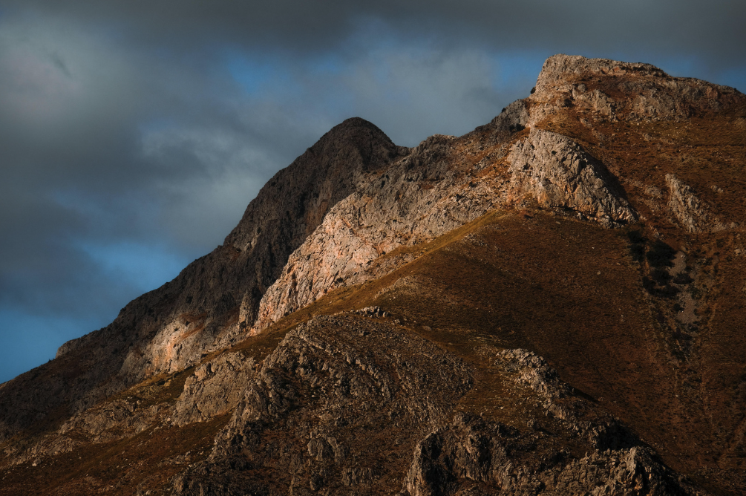
Act Like Men
Men’s Ministry
Teaching & Discussion Series
Started Sunday October 11th
Goes for 4 Weeks
6:00-7:30pm
Meeting at Church

Slide 6
All-Partners Meetings
2027
January 10
Sunday, January 10th
April 11
Sunday, April 11th
August 1
Sunday, August 1st
October 10
Sunday, October 10th

Slide 7
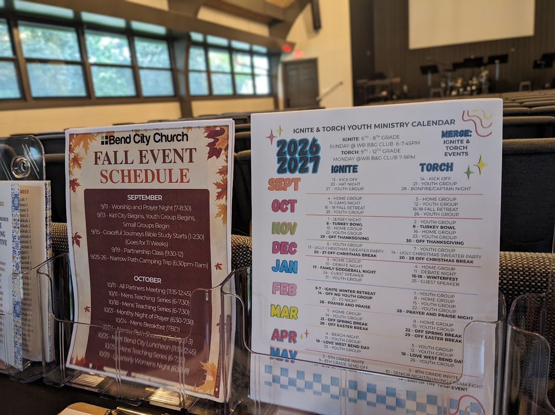
Fall Event & Youth Ministry Schedules
Available on the back table

Slide 8

IGNITE and TORCH City Wide Youth Group
IGNITE: Ministry to 6th-8th Grade Students
“Fueling students to experience Jesus and connect with friends!”
Sundays from 6 pm – 7:45 pm
Boys & Girls Club in West Bend**
TORCH: Ministry to High School Students
“Becoming true disciples of Jesus and representing Him to the world around us!”
Mondays from 7 pm – 9 pm
Boys & Girls Club in West Bend**
**Check Youth Group calendar on the back table for exact schedule.
Times and Locations Vary**

Slide 9
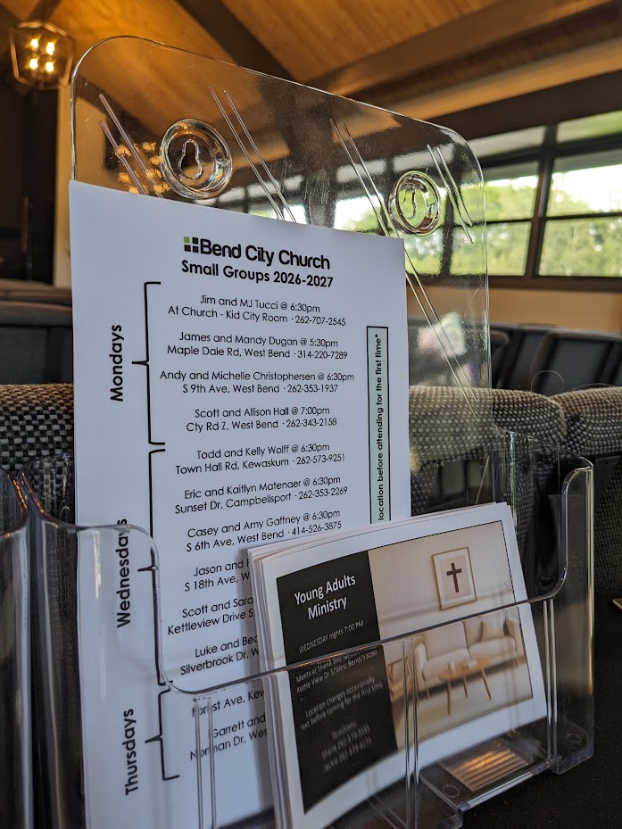
Small Group Information
Available on the back table

Slide 10

Graceful Journeys
Senior Ladies Bible Study
-Meets Tuesdays, 1-2:30pm
-Weekly for 11 Weeks
-Kid City Check-In Room
-For more info Contact Lani
philipharper@sbcglobal.net

Slide 11
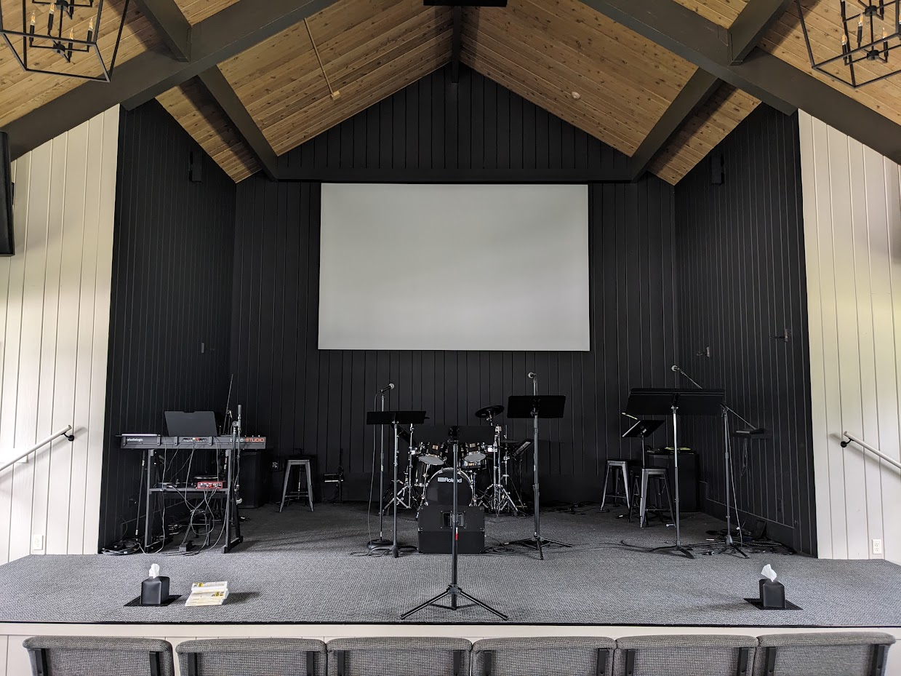
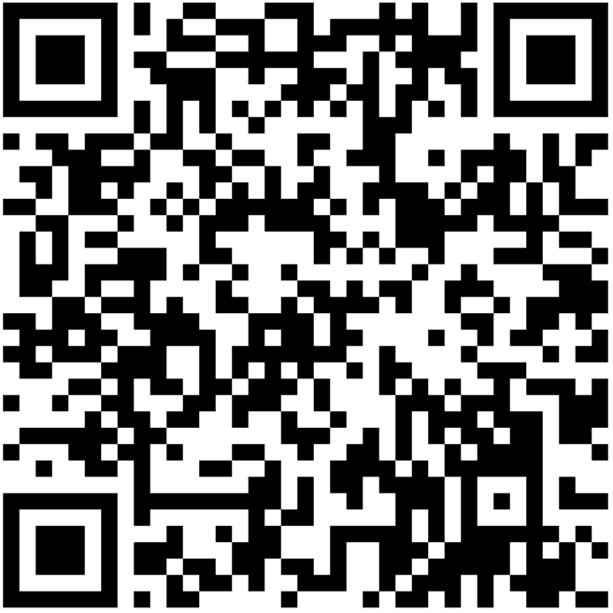
Bend City Sunday Morning Worship
Playlist on Spotify
https://open.spotify.com/playlist/37f5k3SUFPS2hONBoPZw8t?si=RQD9pubZQdOQMLibNPoHIw

Slide 12
Children’s Ministry
Nursery (6mo-4yrs) –
Must be dropped off before service begins
Little Kid City (4K-2nd) – Dismissed after worship
Kid City (3rd – 5th) –
Dismissed after worship

Slide 13
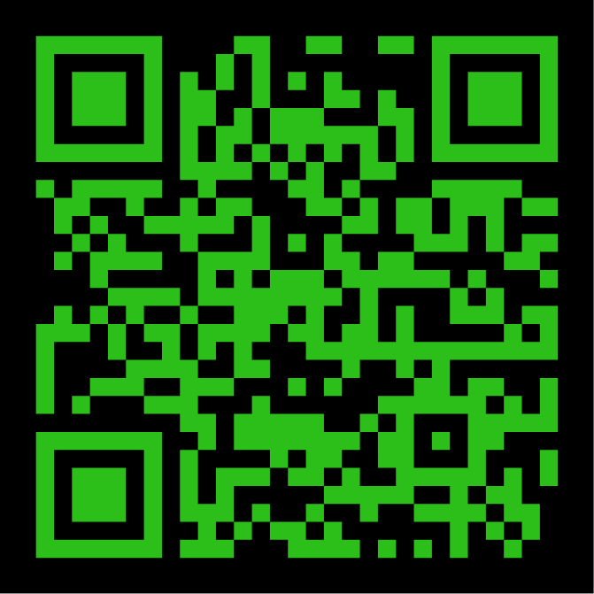

INTERESTED IN
GIVING ONLINE?
1-TIME
OR
RECURRING
NO ACCOUNT REQUIRED
ONREALM.ORG/BENDCITYCHURCH/GIVE

Slide 14

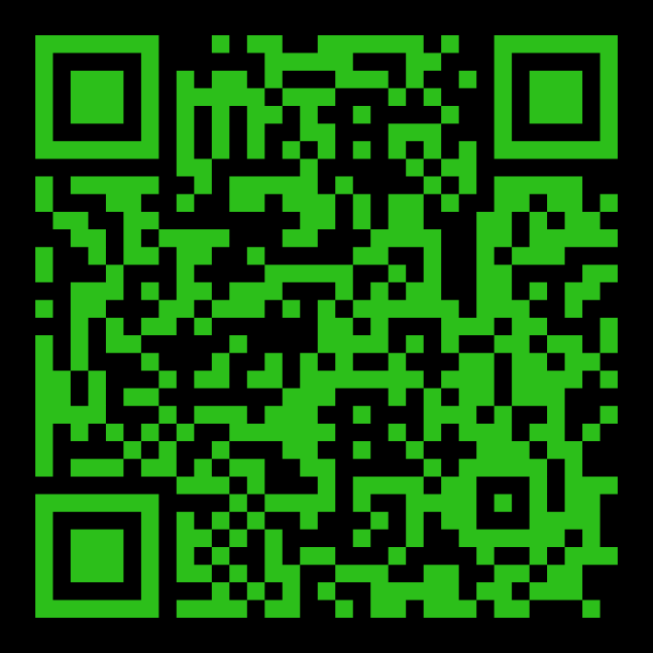
STAY IN THE KNOW WITH
LOG-IN TO SEE POSTS ABOUT UPCOMING EVENTS AND HAPPENINGS AT BEND CITY
WANT TO BE NOTIFIED WHEN SOMETHING NEW GETS POSTED? SIGN-UP FOR EMAILS
https://onrealm.org/BendCityChurch/Account/Start

Slide 15

Young Adults Ministry
WEDNESDAY nights 7:00 PM
Meets at Shane and Jackie’s house
Kettle View Dr S/West Bend/53090
Location changes occasionally
Text before coming for the first time
Questions:
Shane 262-573-3585
Jackie 262-573-4273

Slide 16
OFFERING BOXES: We do not take an offering during the service, however there are offering boxes at the back of the sanctuary on either side of the doors.
FUSSY/NOISY KIDS AREA: located downstairs in the Fellowship Hall near the TV with the service playing.
NURSING MOM’S ROOM: room downstairs right past the restrooms. Has service playing on a TV.

Slide 17
PRAY FOR OUR MISSIONARIES
FOREIGN:
Dany & Keziah Cruz (Hadassah, Analia, Gianna, Tiago, Natalia, Mikael) in Oaxaca, Mexico
Dylan & Angie van Rensburg (Raquel, Gideon, Roman, Grace) who work among the Dem People in Indonesia
Brad & Nora Hayes and the Outstretched Hands of Romania Team
Miguel & Bridget Gomez (Asher, Annette, Miqueas, Grace) in Chalcatongo, Mexico
LOCAL:
Seed of Hope Pregnancy Center and Family Promise

Slide 18

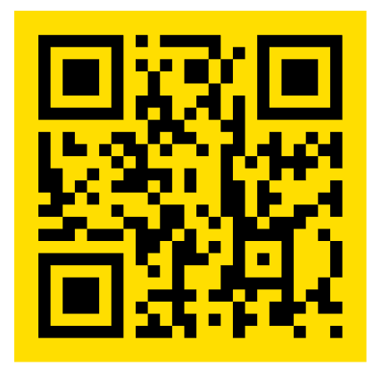
Introducing a new framework for followers of Jesus to welcome and serve Newcomers in the West Bend Community.
Designed to help others navigate cultural and language barriers in order to access resources in our community.
Website: thewelcome.network

