Slide 1

NARROW PATH MINISTRY
FATHERS AND SONS CAMPING
Coming up
Friday, Sept 25th
Overnight
6:30pm Friday
through
11am Saturday
See Jim Martin for more details
jrm6375@gmail.com

Slide 2
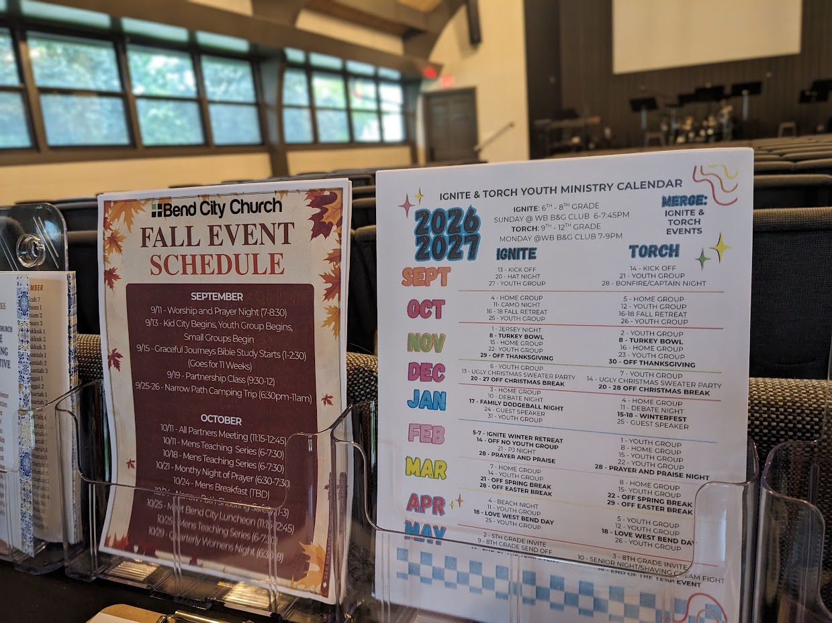
Fall Event & Youth Ministry Schedules
Available on the back table

Slide 3

IGNITE and TORCH City Wide Youth Group
IGNITE: Ministry to 6th-8th Grade Students
Fueling students to experience Jesus and connect with friends!
Sundays from 6 pm – 7:45 pm
Boys & Girls Club in West Bend**
TORCH: Ministry to High School Students
Becoming true disciples of Jesus and representing Him to the world around us!
Mondays from 7 pm – 9 pm
Boys & Girls Club in West Bend**
**Check Youth Group calendar on the back table for exact schedule.
Times and Locations Vary**

Slide 4
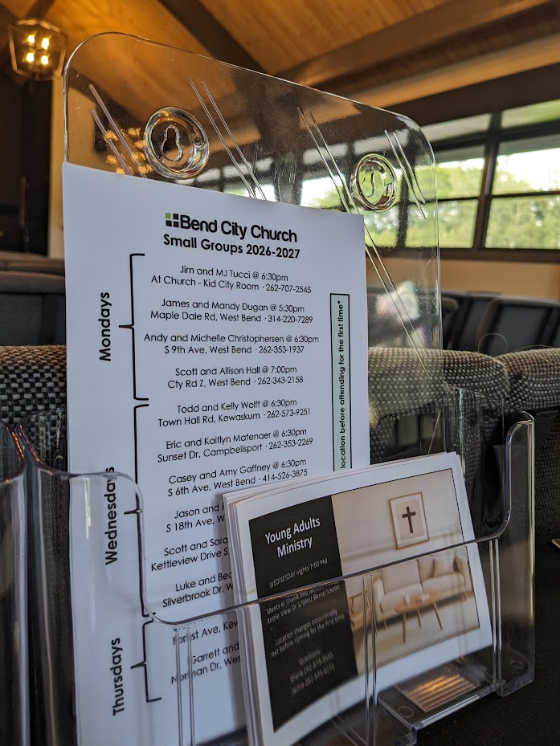
Small Group Information
Available on the back table

Slide 5

Graceful Journeys
Senior Ladies Bible Study
-Meets Tuesdays, 1-2:30pm
-Weekly for 11 Weeks
-Kid City Check-In Room
-For more info Contact Lani
philipharper@sbcglobal.net

Slide 6

Monthly Prayer Night
WEDNESDAY, Oct 21st
6:30-7:30 PM
Kid City Room
The Monthly Prayer Night happens every third Wednesday the month.
(Childcare Provided)

Slide 7
All-Partners Meetings
2026
January 11
Sunday, January 11th
April 12
Sunday, April 12th
August 2
Sunday, August 2nd
October 11
Sunday, October 11th

Slide 8
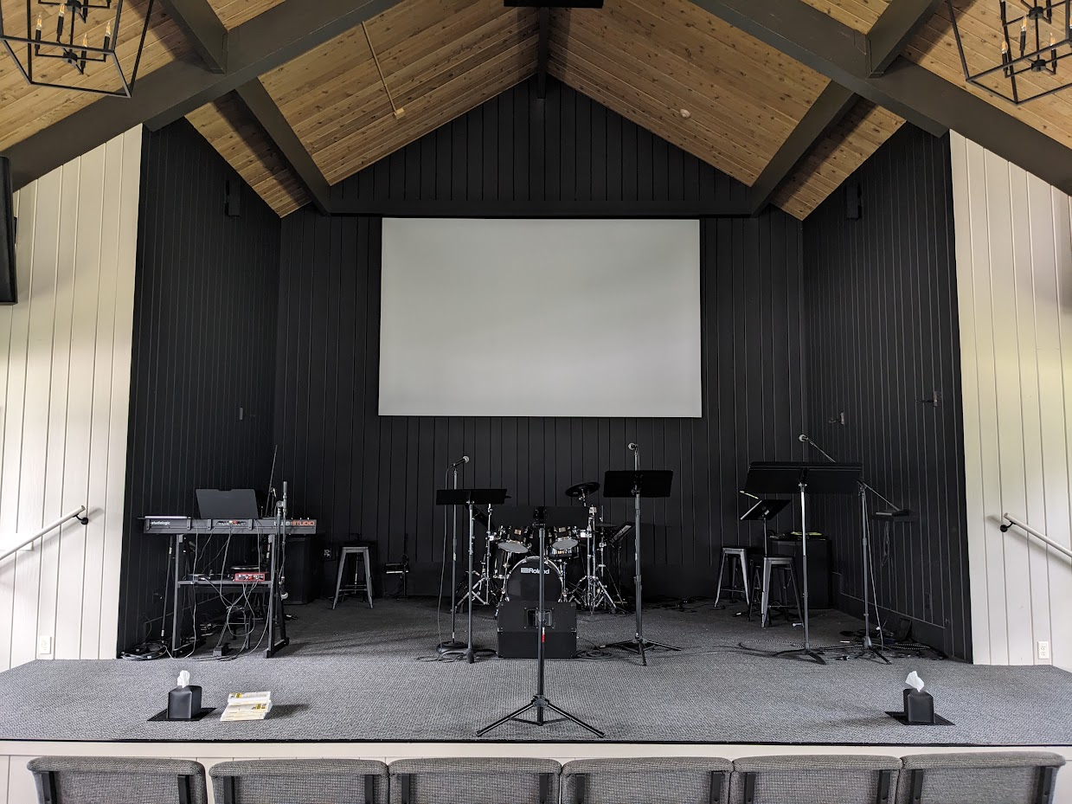
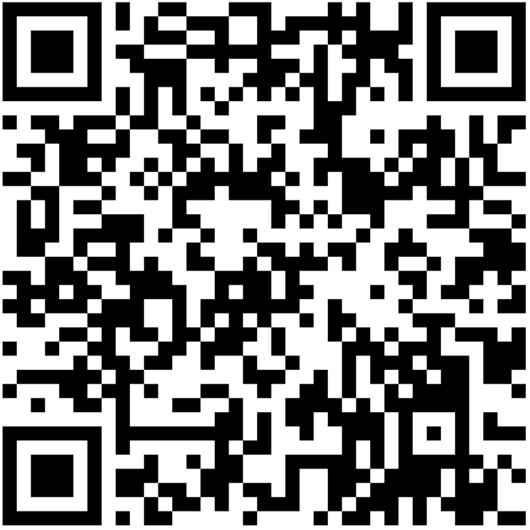
Bend City Sunday Morning Worship
Playlist on Spotify
https://open.spotify.com/playlist/37f5k3SUFPS2hONBoPZw8t?si=RQD9pubZQdOQMLibNPoHIw

Slide 9

Summer Bible Reading Plans
Available at the Back of the Sanctuary or by the coffee in the Fellowship Hall
Goes through September

Slide 10
Children’s Ministry
Nursery (6mo-4yrs) –
Must be dropped off before service begins
Little Kid City (4K-2nd) – Dismissed after worship
Kid City (3rd – 5th) –
Dismissed after worship

Slide 11


INTERESTED IN
GIVING ONLINE?
1-TIME
OR
RECURRING
NO ACCOUNT REQUIRED
ONREALM.ORG/BENDCITYCHURCH/GIVE

Slide 12

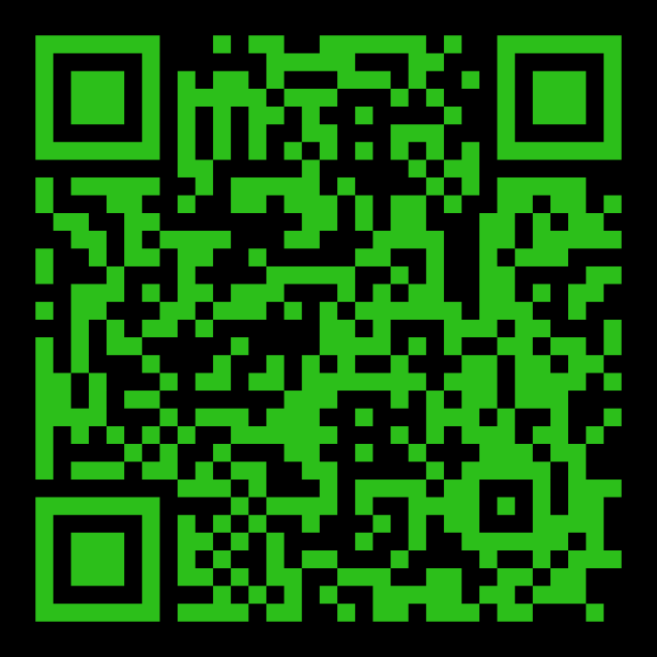
STAY IN THE KNOW WITH
LOG-IN TO SEE POSTS ABOUT UPCOMING EVENTS AND HAPPENINGS AT BEND CITY
WANT TO BE NOTIFIED WHEN SOMETHING NEW GETS POSTED? SIGN-UP FOR EMAILS
https://onrealm.org/BendCityChurch/Account/Start

Slide 13

Young Adults Ministry
WEDNESDAY nights 7:00 PM
Meets at Shane and Jackie’s house
Kettle View Dr S/West Bend/53090
Location changes occasionally
Text before coming for the first time
Questions:
Shane 262-573-3585
Jackie 262-573-4273

Slide 14
OFFERING BOXES: We do not take an offering during the service, however there are offering boxes at the back of the sanctuary on either side of the doors.
FUSSY/NOISY KIDS AREA: located downstairs in the Fellowship Hall near the TV with the service playing.
NURSING MOM’S ROOM: room downstairs right past the restrooms. Has service playing on a TV.

Slide 15
PRAY FOR OUR MISSIONARIES
FOREIGN:
Dany & Keziah Cruz (Hadassah, Analia, Gianna, Tiago, Natalia, Mikael) in Oaxaca, Mexico
Dylan & Angie van Rensburg (Raquel, Gideon, Roman, Grace) who work among the Dem People in Indonesia
Brad & Nora Hayes and the Outstretched Hands of Romania Team
Miguel & Bridget Gomez (Asher, Annette, Miqueas, Grace) in Chalcatongo, Mexico
LOCAL:
Seed of Hope Pregnancy Center and Family Promise

Slide 16

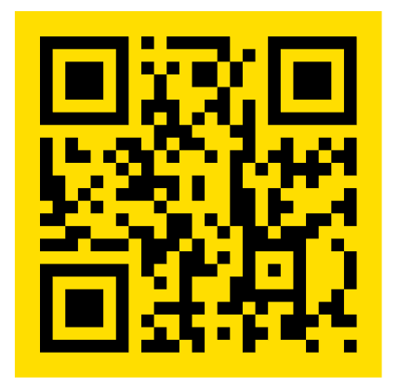
Introducing a new framework for followers of Jesus to welcome and serve Newcomers in the West Bend Community.
Designed to help others navigate cultural and language barriers in order to access resources in our community.
Website: thewelcome.network

