Slide 1

Missionary Luncheon
Please join us for a luncheon and mission field updates after the service with our missionary partners Bridget and Miguel from Living Hope.
TODAY!
After the Service

Slide 2
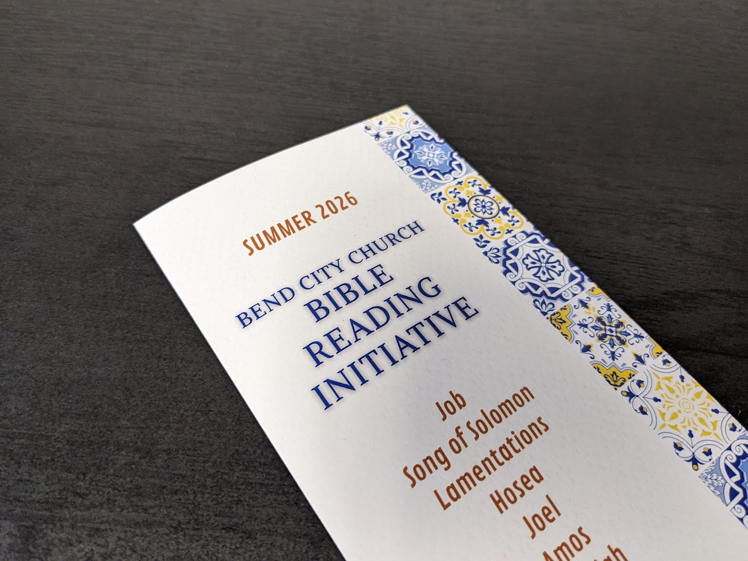
Summer Bible Reading Plans
Available at the Back of the Sanctuary or by the coffee in the Fellowship Hall

Slide 3
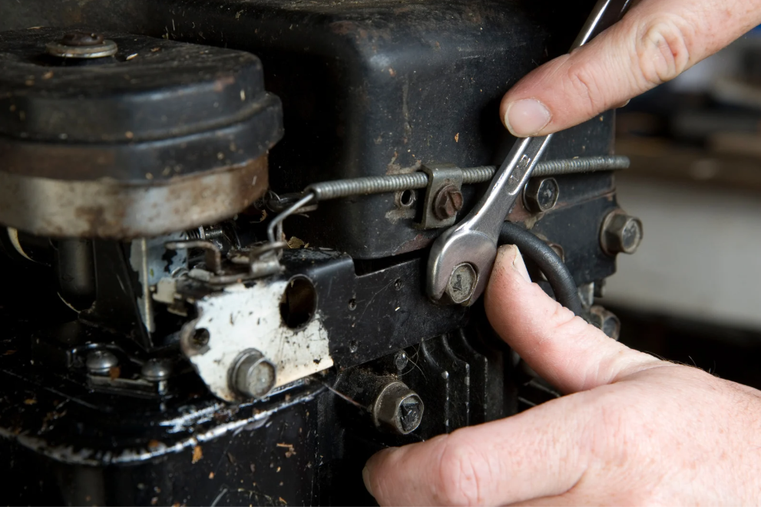
Father’s & Sons
Narrow Path Ministry
Small Engine Repair
Sunday, June 14th
After the Service
Talk with Jim Martin
(jrm6375@gmail.com)

Slide 4
Children’s Ministry
Nursery –
6 months old until the child is in a 4K Classroom
4K-2nd Grade Classroom – Dismissed after worship
Kid City (3rd – 6th) –
Joining the service for Summer (Returning to class in the Fall)

Slide 5

Monthly Prayer Night
WEDNESDAY, June 17th
6:30-7:30 PM
Kid City Room
The Monthly Prayer Night happens every third Wednesday the month.
(Childcare Provided)

Slide 6
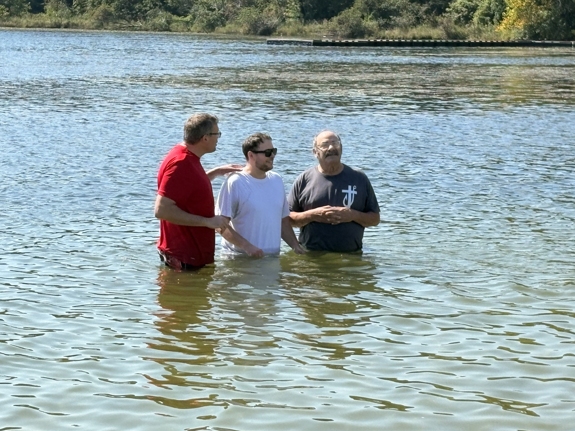
Baptisms at Yahr Park
Sunday, August 9th
Interested in being baptized?
Connect with Luke or Scott
“Go therefore and make disciples of all nations, baptizing them in the name of the Father and of the Son and of the Holy Spirit, teaching them to observe all that I have commanded you. And behold, I am with you always, to the end of the age.”

Slide 7
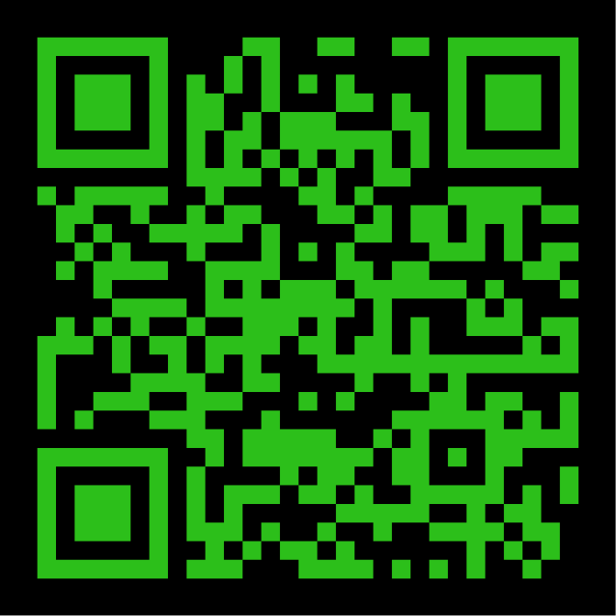

INTERESTED IN
GIVING ONLINE?
1-TIME
OR
RECURRING
NO ACCOUNT REQUIRED
ONREALM.ORG/BENDCITYCHURCH/GIVE

Slide 8

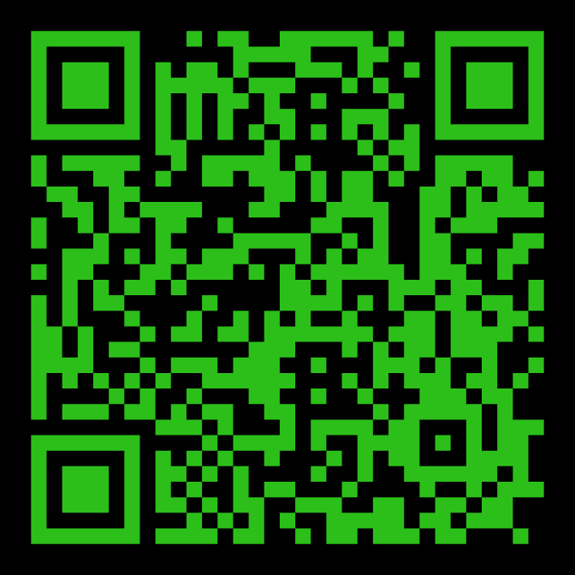
STAY IN THE KNOW WITH
LOG-IN TO SEE POSTS ABOUT UPCOMING EVENTS AND HAPPENINGS AT BEND CITY
WANT TO BE NOTIFIED WHEN SOMETHING NEW GETS POSTED? SIGN-UP FOR EMAILS
https://onrealm.org/BendCityChurch/Account/Start

Slide 9
All Partners Meetings
2026
January 11
Sunday, January 11th
April 12
Sunday, April 12th
August 2
Sunday, August 2nd
October 11
Sunday, October 11th

Slide 10

Graceful Journeys
Senior Ladies Bible Study
-Meets Tuesdays
-Weekly from 1-2:30pm
-Kid City Check-In Room
-Philippians & Ephesians
-For more info Contact Lani

Slide 11

Young Adults Ministry
WEDNESDAY nights 7:00 PM
Meets at Shane and Jackie’s house
Kettle View Dr S/West Bend/53090
Location changes occasionally
Text before coming for the first time
Questions:
Shane 262-573-3585
Jackie 262-573-4273

Slide 12
OFFERING BOXES: We do not take an offering during the service, however there are offering boxes at the back of the sanctuary on either side of the doors.
FUSSY/NOISY KIDS AREA: located downstairs in the Fellowship Hall near the TV with the service playing.
NURSING MOM’S ROOM: room downstairs right past the restrooms. Has service playing on a TV.

Slide 13
PRAY FOR OUR MISSIONARIES
FOREIGN:
Dany & Keziah Cruz (Hadassah, Analia, Gianna, Tiago, Natalia) in Oaxaca, Mexico
Dylan & Angie van Rensburg (Raquel, Gideon, Roman, Grace) who work among the Dem People in Indonesia
Brad & Nora Hayes and the Outstretched Hands of Romania Team
Miguel & Bridget Gomez (Asher, Annette, Miqueas, Grace) in Chalcatongo, Mexico
LOCAL:
Seed of Hope Pregnancy Center and Family Promise

Slide 14

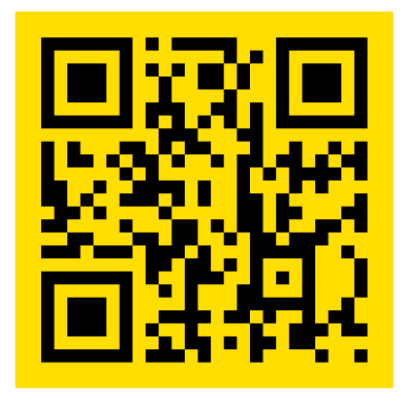
Introducing a new framework for followers of Jesus to welcome and serve Newcomers in the West Bend Community.
Designed to help others navigate cultural and language barriers in order to access resources in our community.
Website: thewelcome.network

