Slide 1

Quarterly
Women’s Night
Thursday, April 30th
6:30pm-8pm
In the Sanctuary

Slide 2

IGNITE and TORCH City Wide Youth Group
IGNITE: Ministry to 6th-8th grade students
Fueling students to experience Jesus and connect with friends!
Sundays from 6 pm – 7:45 pm at Boys & Girls Club
(925 N Silverbrook Dr. West Bend, WI 53090)
TORCH: Ministry to High School Students
Becoming true disciples of Jesus and representing Him to the world around us!
Mondays from 7 pm – 9 pm at Boys & Girls Club
(925 N Silverbrook Dr. West Bend, WI 53090)
**Check Youth Group calendar in the lobby for exact schedule, because sometimes there are Merge events (both middle and high school) or Home Groups at various locations**

Slide 3
Upcoming Baptism
Next Sunday, May 3rd
Interested in being baptized?
See Scott up by the stage after the service.
“Go therefore and make disciples of all nations, baptizing them in the name of the Father and of the Son and of the Holy Spirit, teaching them to observe all that I have commanded you. And behold, I am with you always, to the end of the age.”

Slide 4

Father’s & Sons
Narrow Path Ministry
Finance Class
Next Sunday, May 3rd
Here at the Church
Following the Service
Talk with Jim Martin for more info
jrm6375@gmail.com

Slide 5
Men’s Conference
“Straining Towards the Goal Together”
SAVE THE DATE:
Combined Breakfast & Conference
Saturday May 16th
8:30am-Noon
Free

Slide 6
All Partners Meetings
2026
January 11
Sunday, January 11th
April 12
Sunday, April 12th
August 2
Sunday, August 2nd
October 11
Sunday, October 11th

Slide 7

Monthly Prayer Night
WEDNESDAY, May 20th
6:30-7:30 PM
Kid City Room
The Monthly Prayer Night happens every third Wednesday the month.
(Childcare Provided)

Slide 8

Graceful Journeys
Senior Ladies Bible Study
-Meets Tuesdays
-Weekly from 1-2:30pm
-Kid City Check-In Room
-Philippians & Ephesians
-For more info Contact Lani

Slide 9

Young Adults Ministry
WEDNESDAY nights 7:00 PM
Meets at Shane and Jackie’s house
Kettle View Dr S/West Bend/53090
Location changes occasionally
Text before coming for the first time
Questions:
Shane 262-573-3585
Jackie 262-573-4273

Slide 10

BCC Bible Reading Initiative
BCC Bible Reading Initiative
Our goal is to create a healthy habit of Bible reading among the body, to encourage and admonish one another towards love for God and everyone else around us. As we face the adversity among the world, our unity through the Word is essential.
Grab your bible reading plans from the table in the back of the sanctuary or by the lower-level entrance.

Slide 11
Children’s Ministry
Nursery – 6 months old until the child is in a 4K Classroom
4K-2nd Grade Classroom – dismissed after worship
Kid City (3rd – 6th) –
dismissed after worship

Slide 12

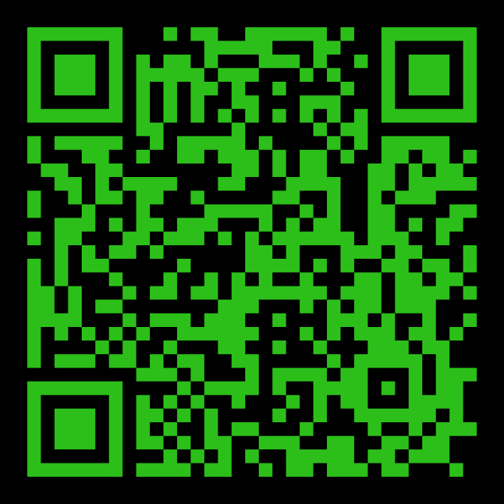
STAY IN THE KNOW WITH
LOG-IN TO SEE POSTS ABOUT UPCOMING EVENTS AND HAPPENINGS AT BEND CITY
WANT TO BE NOTIFIED WHEN SOMETHING NEW GETS POSTED? SIGN-UP FOR EMAILS
https://onrealm.org/BendCityChurch/Account/Start

Slide 13
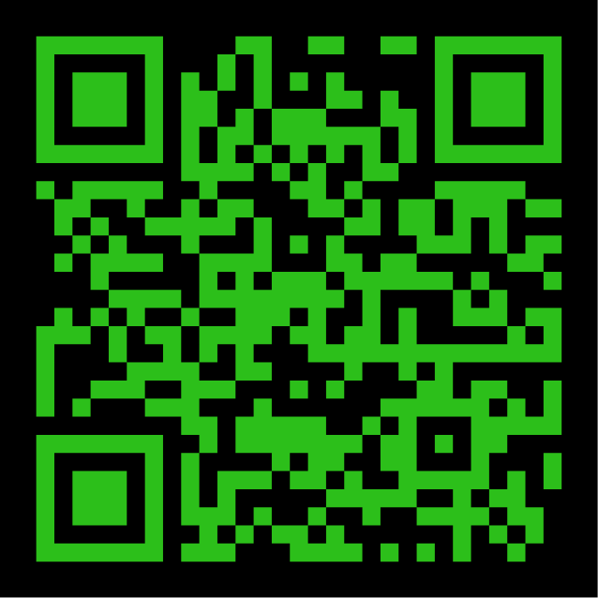

INTERESTED IN
GIVING ONLINE?
1-TIME
OR
RECURRING
NO ACCOUNT REQUIRED
ONREALM.ORG/BENDCITYCHURCH/GIVE

Slide 14
OFFERING BOXES: We do not take an offering during the service, however there are offering boxes at the back of the sanctuary on either side of the doors.
FUSSY/NOISY KIDS AREA: located downstairs in the Fellowship Hall near the TV with the service playing.
NURSING MOM’S ROOM: room downstairs right past the restrooms. Has service playing on a TV.

Slide 15
PRAY FOR OUR MISSIONARIES
FOREIGN:
Dany & Keziah Cruz (Hadassah, Analia, Gianna, Tiago, Natalia) in Oaxaca, Mexico
Dylan & Angie van Rensburg (Raquel, Gideon, Roman, Grace) who work among the Dem People in Indonesia
Brad & Nora Hayes and the Outstretched Hands of Romania Team
Miguel & Bridget Gomez (Asher, Annette, Miqueas, Grace) in Chalcatongo, Mexico
LOCAL:
Seed of Hope Pregnancy Center and Family Promise

Slide 16

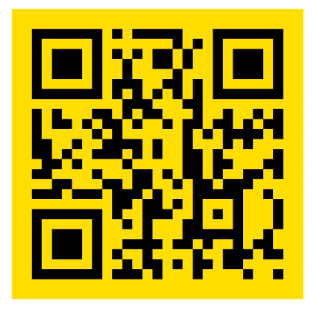
Introducing a new framework for followers of Jesus to welcome and serve Newcomers in the West Bend Community.
Designed to help others navigate cultural and language barriers in order to access resources in our community.
Website: thewelcome.network

