Slide 1
Join us for our Upcoming Special Services:
Good Friday
April 3rd - 4-5pm
Easter Sunday
April 5th - 9:30-11am

Slide 2
All Partners Meetings
2026
January 11
Sunday, January 11th
April 12
Sunday, April 12th
August 2
Sunday, August 2nd
October 11
Sunday, October 11th

Slide 3

Graceful Journeys
Senior Ladies Bible Study
-Meets Tuesdays
-Weekly from 1-2:30pm
-Kid City Check-In Room
-Philippians & Ephesians
-For more info Contact Lani

Slide 4

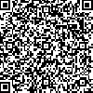
Bend City Church, April 18th from 5:30-8pm
Register @ bendcitychurch.org under the “Events” tab by April 12th
Silent Auction I Smoked Meats Dinner I Tickets - $35 I Updates from Brand and Nora Hayes

Slide 5


Slide 6

Ladies Video Series Bible/Book Study
Sunday Evenings
Six Weeks
6:00-7:30 PM
Based on the book “Get Out of Your Head” by Jennie Allen
Starting:
Sunday, February 15th

Slide 7
Mom’s Morning Out
Breakfast
Friday, April 25th
9:00-11:00 AM
Pionkowski’s Home

Slide 8


Father’s & Sons
Narrow Path Ministry
Materials Needed
for Participation
Talk with Jim Martin
(jrm6375@gmail.com)
WOODWORKING
Sunday, March 22nd 1-3pm

Slide 9

Young Adults Ministry
WEDNESDAY nights 7:00 PM
Meets at Shane and Jackie’s house
Kettle View Dr S/West Bend/53090
Location changes occasionally
Text before coming for the first time
Questions:
Shane 262-573-3585
Jackie 262-573-4273

Slide 10

BCC Bible Reading Initiative
BCC Bible Reading Initiative
Our goal is to create a healthy habit of Bible reading among the body, to encourage and admonish one another towards love for God and everyone else around us. As we face the adversity among the world, our unity through the Word is essential.
Grab your bible reading plans from the table in the back of the sanctuary or by the lower-level entrance.

Slide 11

IGNITE and TORCH City Wide Youth Group
IGNITE: Ministry to 6th-8th grade students
Fueling students to experience Jesus and connect with friends!
Sundays from 6 pm – 7:45 pm at Boys & Girls Club
(925 N Silverbrook Dr. West Bend, WI 53090)
TORCH: Ministry to High School Students
Becoming true disciples of Jesus and representing Him to the world around us!
Mondays from 7 pm – 9 pm at Boys & Girls Club
(925 N Silverbrook Dr. West Bend, WI 53090)
**Check Youth Group calendar in the lobby for exact schedule, because sometimes there are Merge events (both middle and high school) or Home Groups at various locations**

Slide 12
Children’s Ministry
Nursery – 6 months old until the child is in a 4K Classroom
4K-2nd Grade Classroom – dismissed after worship
Kid City (3rd – 6th) –
dismissed after worship

Slide 13


STAY IN THE KNOW WITH
LOG-IN TO SEE POSTS ABOUT UPCOMING EVENTS AND HAPPENINGS AT BEND CITY
WANT TO BE NOTIFIED WHEN SOMETHING NEW GETS POSTED? SIGN-UP FOR EMAILS
https://onrealm.org/BendCityChurch/Account/Start

Slide 14


INTERESTED IN
GIVING ONLINE?
1-TIME
OR
RECURRING
NO ACCOUNT REQUIRED
ONREALM.ORG/BENDCITYCHURCH/GIVE

Slide 15
OFFERING BOXES: We do not take an offering during the service, however there are offering boxes at the back of the sanctuary on either side of the doors.
FUSSY/NOISY KIDS AREA: located downstairs in the Fellowship Hall near the TV with the service playing.
NURSING MOM’S ROOM: room downstairs right past the restrooms. Has service playing on a TV.

Slide 16
PRAY FOR OUR MISSIONARIES
FOREIGN:
Dany & Keziah Cruz (Hadassah, Analia, Gianna, Tiago, Natalia) in Oaxaca, Mexico
Dylan & Angie van Rensburg (Raquel, Gideon, Roman, Grace) who work among the Dem People in Indonesia
Brad & Nora Hayes and the Outstretched Hands of Romania Team
Miguel & Bridget Gomez (Asher, Annette, Miqueas, Grace) in Chalcatongo, Mexico
LOCAL:
Seed of Hope Pregnancy Center and Family Promise

Slide 17

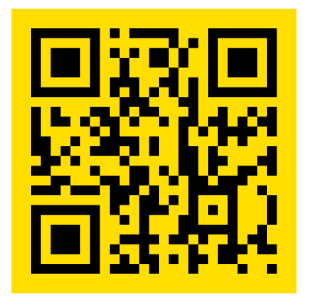
Introducing a new framework for followers of Jesus to welcome and serve Newcomers in the West Bend Community.
Designed to help others navigate cultural and language barriers in order to access resources in our community.
Website: thewelcome.network

