Slide 1
Mom’s Morning Out
Friday, March 20th
10:00-11:30 AM
Kid City Room (downstairs)
Childcare provided in Nursery

Slide 2

Friday, March 20th - Bend City Church - 7:00-8:30pm

Slide 3
Partnership class & identity class opportunities
WHAT:
  Partnership Class: For those Interested in becoming a partner with Bend City or those simply interested in sharpening your knowledge on about the Foundations of Faith.
  Identity Class: For those looking to meditate on what it looks like to practically find their identity in Christ.
WHEN: Saturday, March 21st 9:30am-noon
WHERE: Downstairs in various classrooms
INTERESTED? SIGN-UP ON THE BACK TABLE

Slide 4


Slide 5
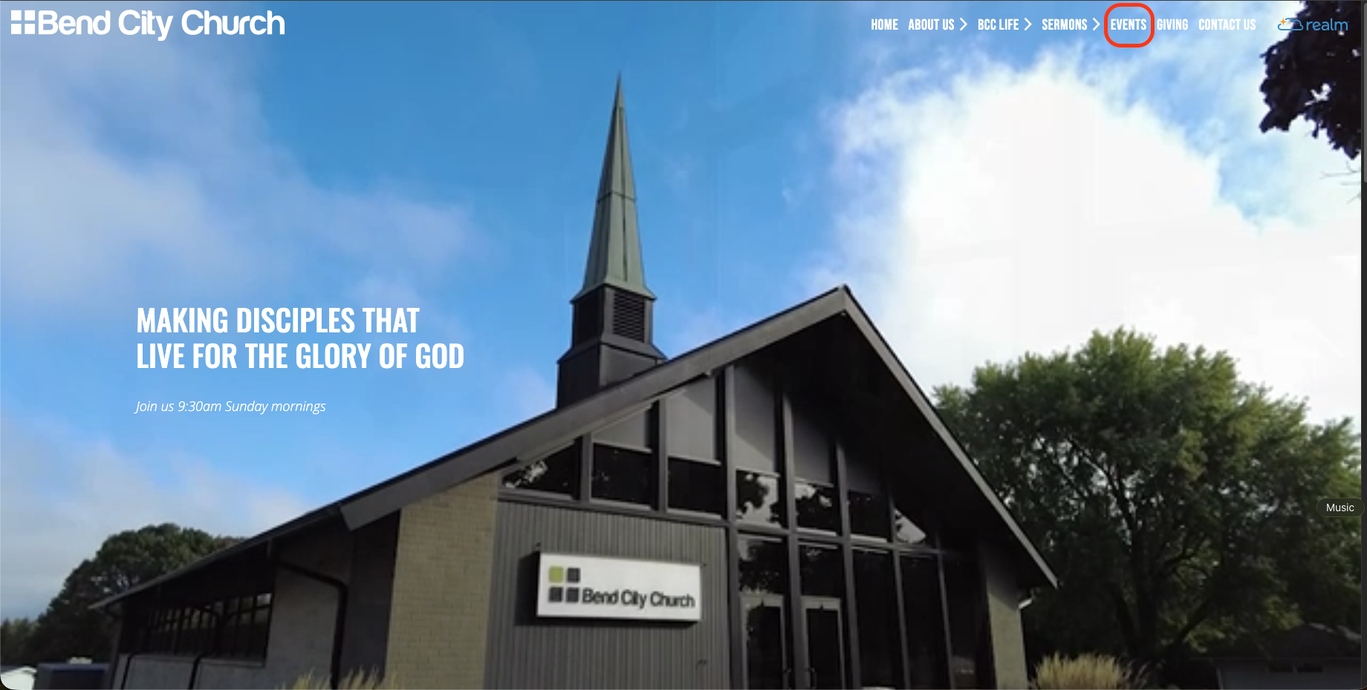
REGISTRATION: STEP 1

Slide 6
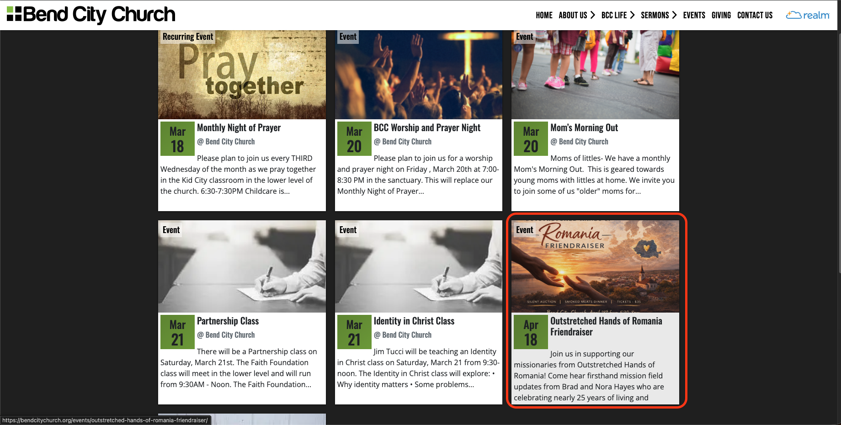
REGISTRATION: STEP 2

Slide 7
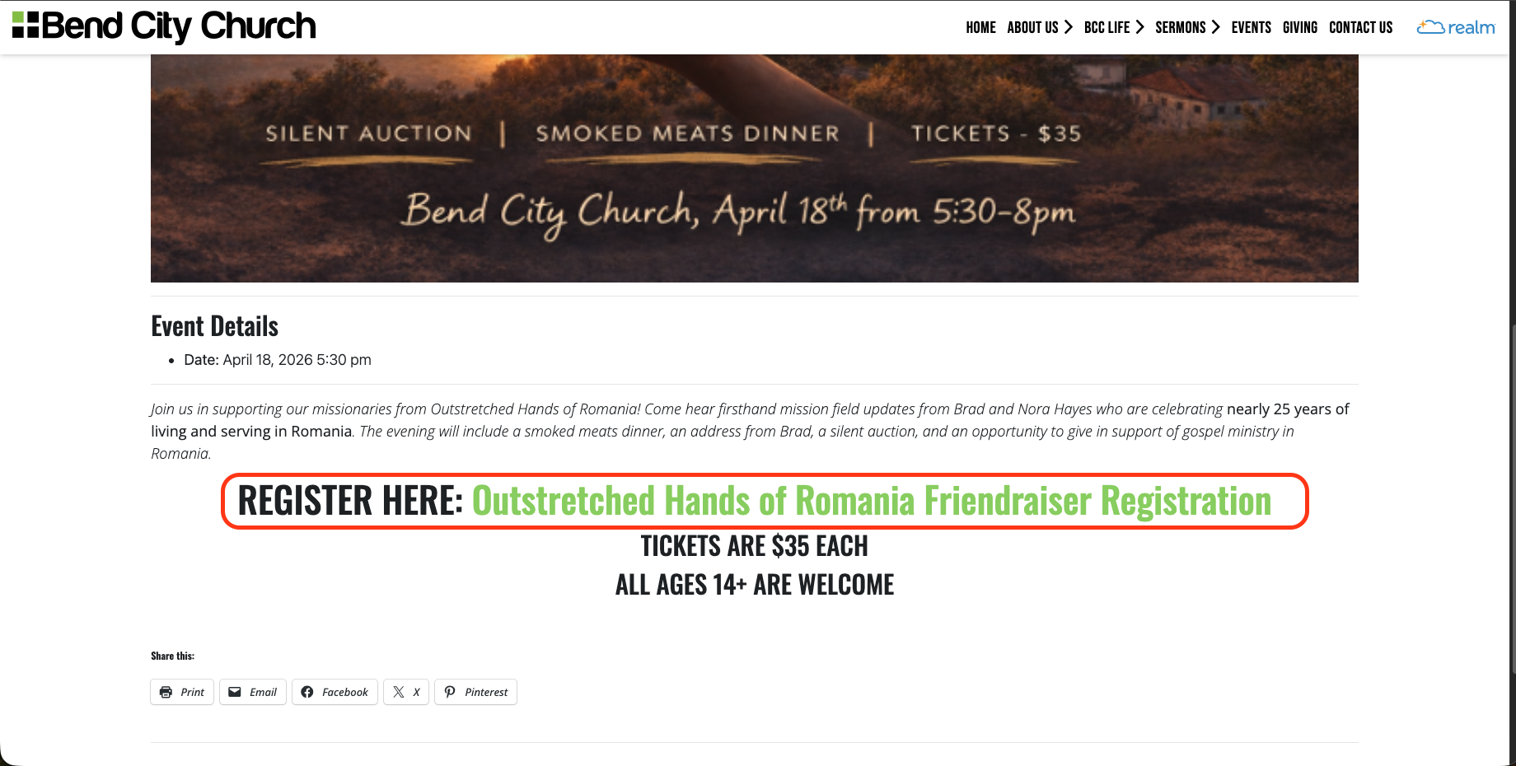
REGISTRATION: STEP 3

Slide 8


Father’s & Sons
Narrow Path Ministry
Materials Needed
for Participation
Talk with Jim Martin
(jrm6375@gmail.com)
WOODWORKING
Sunday, March 22nd 1-3pm

Slide 9

Ladies Video Series Bible/Book Study
Sunday Evenings
Six Weeks
6:00-7:30 PM
Based on the book “Get Out of Your Head” by Jennie Allen
Starting:
Sunday, February 15th

Slide 10
All Partners Meetings
2026
January 11
Sunday, January 11th
April 12
Sunday, April 12th
August 2
Sunday, August 2nd
October 11
Sunday, October 11th

Slide 11

Young Adults Ministry
WEDNESDAY nights 7:00 PM
Meets at Shane and Jackie’s house
Kettle View Dr S/West Bend/53090
Location changes occasionally
Text before coming for the first time
Questions:
Shane 262-573-3585
Jackie 262-573-4273

Slide 12

BCC Bible Reading Initiative
BCC Bible Reading Initiative
Our goal is to create a healthy habit of Bible reading among the body, to encourage and admonish one another towards love for God and everyone else around us. As we face the adversity among the world, our unity through the Word is essential.
Grab your bible reading plans from the table in the back of the sanctuary or by the lower-level entrance.

Slide 13

IGNITE and TORCH City Wide Youth Group
IGNITE: Ministry to 6th-8th grade students
Fueling students to experience Jesus and connect with friends!
Sundays from 6 pm – 7:45 pm at Boys & Girls Club
(925 N Silverbrook Dr. West Bend, WI 53090)
TORCH: Ministry to High School Students
Becoming true disciples of Jesus and representing Him to the world around us!
Mondays from 7 pm – 9 pm at Boys & Girls Club
(925 N Silverbrook Dr. West Bend, WI 53090)
**Check Youth Group calendar in the lobby for exact schedule, because sometimes there are Merge events (both middle and high school) or Home Groups at various locations**

Slide 14
Children’s Ministry
Nursery – 6 months old until the child is in a 4K Classroom
4K-2nd Grade Classroom – dismissed after worship
Kid City (3rd – 6th) –
dismissed after worship

Slide 15


STAY IN THE KNOW WITH
LOG-IN TO SEE POSTS ABOUT UPCOMING EVENTS AND HAPPENINGS AT BEND CITY
WANT TO BE NOTIFIED WHEN SOMETHING NEW GETS POSTED? SIGN-UP FOR EMAILS
https://onrealm.org/BendCityChurch/Account/Start

Slide 16


INTERESTED IN
GIVING ONLINE?
1-TIME
OR
RECURRING
NO ACCOUNT REQUIRED
ONREALM.ORG/BENDCITYCHURCH/GIVE

Slide 17
OFFERING BOXES: We do not take an offering during the service, however there are offering boxes at the back of the sanctuary on either side of the doors.
FUSSY/NOISY KIDS AREA: located downstairs in the Fellowship Hall near the TV with the service playing.
NURSING MOM’S ROOM: room downstairs right past the restrooms. Has service playing on a TV.

Slide 18
PRAY FOR OUR MISSIONARIES
FOREIGN:
Dany & Keziah Cruz (Hadassah, Analia, Gianna, Tiago, Natalia) in Oaxaca, Mexico
Dylan & Angie van Rensburg (Raquel, Gideon, Roman, Grace) who work among the Dem People in Indonesia
Brad & Nora Hayes and the Outstretched Hands of Romania Team
Miguel & Bridget Gomez (Asher, Annette, Miqueas, Grace) in Chalcatongo, Mexico
LOCAL:
Seed of Hope Pregnancy Center and Family Promise

Slide 19

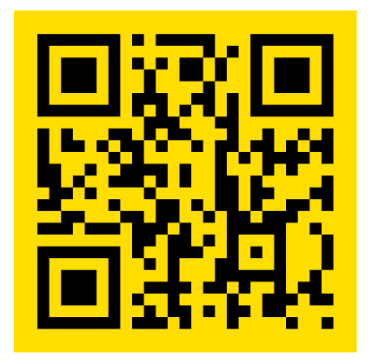
Introducing a new framework for followers of Jesus to welcome and serve Newcomers in the West Bend Community.
Designed to help others navigate cultural and language barriers in order to access resources in our community.
Website: thewelcome.network

