Slide 1

Romania Missions Trip
10 Days over Thanksgiving Break 2026
Commitment Deadline and $100 Deposit Due:
Feb 15th, 2026
See Scott or Sarah Schampers for more info.

Slide 2

Fasting/Praying in February
THIS YEAR:
We are asking all of us to pray specifically for:
1) Delight in the Lord
Pray that each person at Bend City would delight in time with God—not just doing the right things, but enjoying communion with Christ.
2) Outreach to our community
Pray that the Lord would open doors for gospel ministry in our community and show us specific ways to serve and share Christ.
3) A larger space
Pray for wisdom and provision as we pursue a larger meeting space for our Sunday gatherings.
4) More leaders
Pray that God would raise up more leaders so that every member is strengthened and the church remains healthy as we grow.

Slide 3

Ladies Video Series Bible/Book Study
Sunday Evenings
Six Weeks
6:00-7:30 PM
Based on the book “Get Out of Your Head” by Jennie Allen
Starting:
Sunday, February 15th

Slide 4

Monthly Prayer Night
The Monthly Prayer Night happens every third Wednesday the month. The next gathering will be:
WEDNESDAY, FEBRUARY 18TH
from 6:30-7:30 PM downstairs in Kid City Room.
Childcare is provided.

Slide 5
Mom’s Morning Out
Thursday, February 19th
10:00-11:30 AM
Kid City Room (downstairs)
Childcare provided in Nursery

Slide 6

Men’s Breakfast
Saturday, February 21st
8:30 AM
In the Fellowship Hall in the lower level at church
Speaker: Isaiah Richie

Slide 7

Are You New Around Here?
Sign-up and Join us for a
Meet Bend City Luncheon
Sunday, February 22nd
Following the Service
Downstairs in the Fellowship Hall

Slide 8
All Partners Meetings
2026
January 11
Sunday, January 11th
April 12
Sunday, April 12th
August 2
Sunday, August 2nd
October 11
Sunday, October 11th

Slide 9

Young Adults Ministry
WEDNESDAY nights 7:00 PM
Meets at Shane and Jackie’s house
Kettle View Dr S/West Bend/53090
Location changes occasionally
Text before coming for the first time
Questions:
Shane 262-573-3585
Jackie 262-573-4273

Slide 10

BCC Bible Reading Initiative
BCC Bible Reading Initiative
Our goal is to create a healthy habit of Bible reading among the body, to encourage and admonish one another towards love for God and everyone else around us. As we face the adversity among the world, our unity through the Word is essential.
Grab your bible reading plans from the table in the back of the sanctuary or by the lower-level entrance.

Slide 11

IGNITE and TORCH City Wide Youth Group
IGNITE: Ministry to 6th-8th grade students
Fueling students to experience Jesus and connect with friends!
Sundays from 6 pm – 7:45 pm at Boys & Girls Club
(925 N Silverbrook Dr. West Bend, WI 53090)
TORCH: Ministry to High School Students
Becoming true disciples of Jesus and representing Him to the world around us!
Mondays from 7 pm – 9 pm at Boys & Girls Club
(925 N Silverbrook Dr. West Bend, WI 53090)
**Check Youth Group calendar in the lobby for exact schedule, because sometimes there are Merge events (both middle and high school) or Home Groups at various locations**

Slide 12
Children’s Ministry
Nursery – 6 months old until the child is in a 4K Classroom
4K-2nd Grade Classroom – dismissed after worship
Kid City (3rd – 6th) –
dismissed after worship

Slide 13

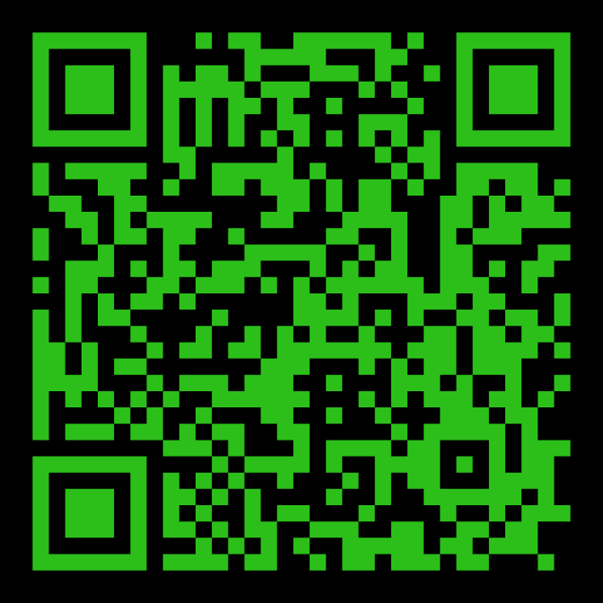
STAY IN THE KNOW WITH
LOG-IN TO SEE POSTS ABOUT UPCOMING EVENTS AND HAPPENINGS AT BEND CITY
WANT TO BE NOTIFIED WHEN SOMETHING NEW GETS POSTED? SIGN-UP FOR EMAILS
https://onrealm.org/BendCityChurch/Account/Start

Slide 14
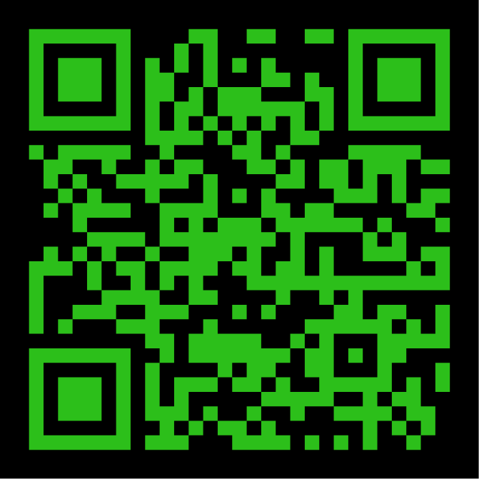

INTERESTED IN
GIVING ONLINE?
1-TIME
OR
RECURRING
NO ACCOUNT REQUIRED
ONREALM.ORG/BENDCITYCHURCH/GIVE

Slide 15
OFFERING BOXES: We do not take an offering during the service, however there are offering boxes at the back of the sanctuary on either side of the doors.
FUSSY/NOISY KIDS AREA: located downstairs in the Fellowship Hall near the TV with the service playing.
NURSING MOM’S ROOM: room downstairs right past the restrooms. Has service playing on a TV.

Slide 16
PRAY FOR OUR MISSIONARIES
FOREIGN:
Dany & Keziah Cruz (Hadassah, Analia, Gianna, Tiago, Natalia) in Oaxaca, Mexico
Dylan & Angie van Rensburg (Raquel, Gideon, Roman, Grace) who work among the Dem People in Indonesia
Brad & Nora Hayes and the Outstretched Hands of Romania Team
Miguel & Bridget Gomez (Asher, Annette, Miqueas, Grace) in Chalcatongo, Mexico
LOCAL:
Seed of Hope Pregnancy Center and Family Promise

Slide 17

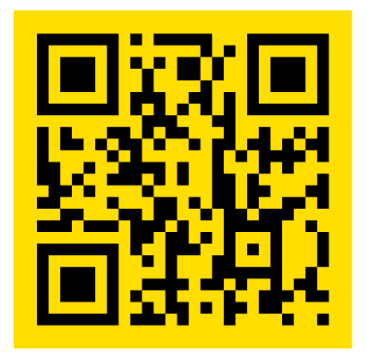
Introducing a new framework for followers of Jesus to welcome and serve Newcomers in the West Bend Community.
Designed to help others navigate cultural and language barriers in order to access resources in our community.
Website: thewelcome.network

